Slide 1
El Gamal CRYPTOSYSTEM
FOR IMAGE ENCRYPTION AND DECRYPTION

Slide 2
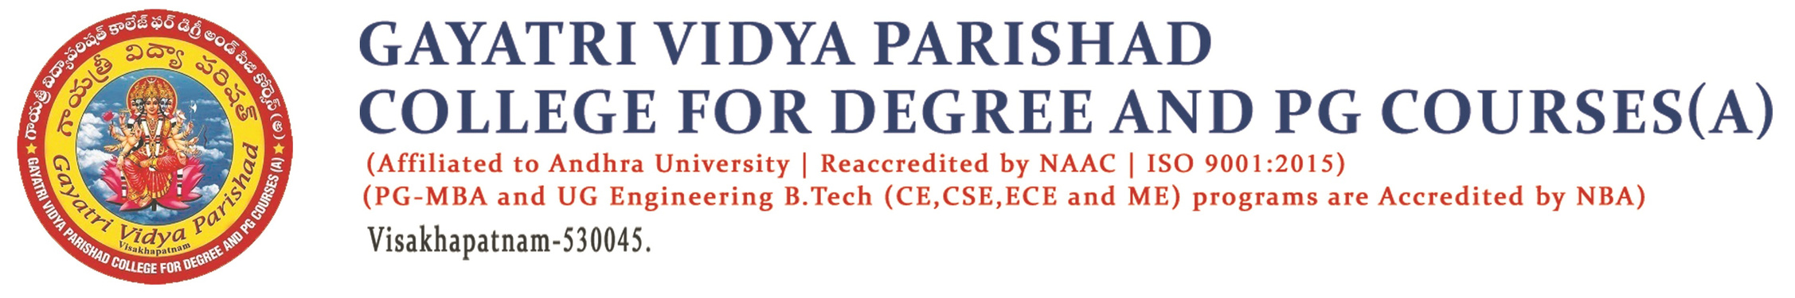
Project By:
G . Sai Sudheer
PG212202021
MCA 4th semester
Project Guide:
Mr. P . Venkata Rao
Associate Professor

Slide 3
Contents
Abstract
Introduction
Existing system
Proposed system
Algorithm
Example
Conclusion

Slide 4
Abstract
El Gamal cryptosystem is one of the well-known public-key algorithms for its ability to generate different ciphertexts for the same plaintext on successive runs. However, this algorithm results in a ciphertext occupying a larger memory space than its plaintext due to its encryption nature. As a result, it is pretty infeasible to use data that require their encrypted form to have the same, such as image data. To overcome this issue, propose a new El Gamal cryptosystem that can be used for any digital data message, including images and text.

Slide 5
Introduction
El Gamal encryption is a public-key cryptosystem. It uses asymmetric key encryption for communicating between two parties and encrypting the message.
This generates a set of bytes with the same approximately equal to the number of bytes in the given message during the encryption process. This is accomplished by using the public key information from the user to whom the encrypted message is to be sent.
To prevent the encrypted message from having a larger than its original message during the encryption process, perform an XOR operation between each byte of the original message and one byte of a randomly generated set of bytes at a time.

Slide 6
Existed System
El Gamal cryptosystem can be defined as the cryptography algorithm that uses the public and private key concepts to secure communication between two systems. It can be considered the asymmetric algorithm where the encryption and decryption happen by using public and private keys. However, this algorithm results in a ciphertext occupying a larger memory space than its plaintext due to its encryption nature. As a result, it is pretty infeasible to use data that require their encrypted form to have the same such as image data.

Slide 7
Proposed System
The proposed approach mainly tests image data, consisting of three stages: key pair generation, image encryption, and image decryption. First, we generate as many random bytes as required for encrypting or decrypting images using the sender or receiver's public key information. Then use an XOR operation between each pixel in the image and each randomly generated byte to obtain the encrypted or decrypted image.

Slide 8
ALGORITHIM
Image Encryption:
Input: im ,p, a and y.
Output: im and Bp.
Step1: Read im ,p, a and y.
Step2. Initialize Bp and fsk as follows :Bp=[] and fsk=[].
Step3: Initialize im with im zeros , so its shape and type are identical to im.
Step4: Select k(a random integer) such that 1<k<p-2
Step5: Compute d as in (2).
Step6: Append d into Bp.
Step7: Compute sk as in (6)
Step 8: Convert the sk into a set of bytes and then append each byte separately into fsk.
Step9: If len(fsk) is less than len(im) go to step 4
Step 10: Compute im as in (7) to obtain an encrypted image

Slide 9
Image Decryption:
Input: im , Bp , p and x
Output: im
Step1: Read im , Bp, p and x.
Step2: Initialize fsk as follows: fsk=[]
Step3: Initialize im with im zeros, so its shape and type are identical to im
Step4: Divide Bp into a set of blocks as follows : Bp1,Bp2,…Bpn-1.
Step5: For each block Bpi , do the following:
1)Compute sk as in(8)
2)Convert the sk into a set of bytes and then append each byte
separately into fsk
Step6: Compute imijc as in (9) to obtain the original image

Slide 10
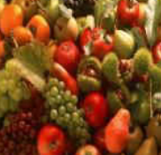
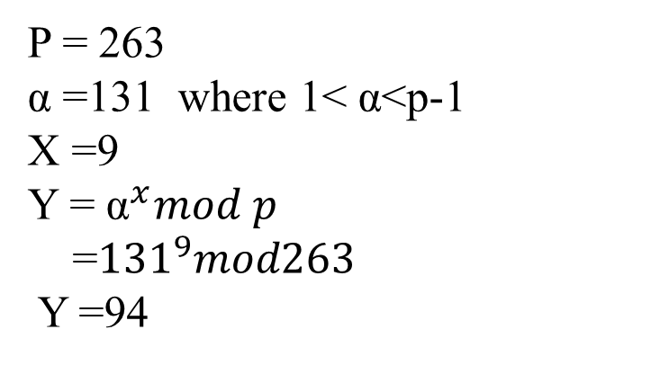
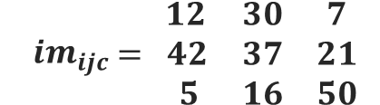
Example
$${im}_{ijc}\begin{matrix} 12 & 30 & 7 \\ = 42 & 37 & 21 \\ 5 & 16 & 50\end{matrix}$$
Key Generation:
P = 263
α =131 where 1< α<p-1
X =9
Y = $α^{x}mod p$
=${131}^{9}mod263$
Y =94

Slide 11
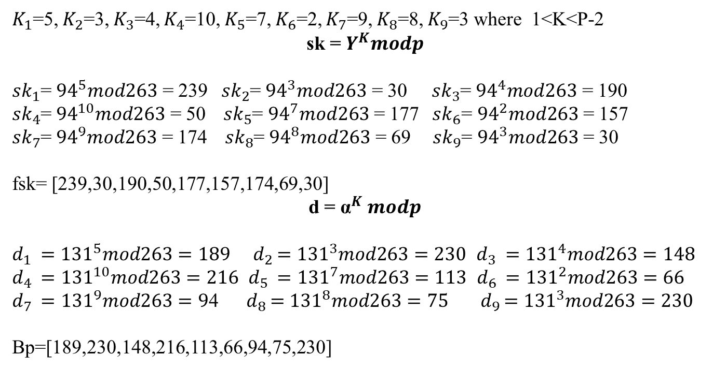
Encryption :
$K_{1}$=5, $K_{2}$=3, $K_{3}$=4, $K_{4}$=10, $K_{5}$=7, $K_{6}$=2, $K_{7}$=9, $K_{8}$=8, $K_{9}$=3 where 1<K<P-2
sk = $Y^{K}modp$
${sk}_{1}$= ${94}^{5}mod263$ = 239 ${ sk}_{2}$= ${94}^{3}mod263$ = 30 ${sk}_{3}$= ${94}^{4}mod263$ = 190
${sk}_{4}$= ${94}^{10}mod263$ = 50 ${ sk}_{5}$= ${94}^{7}mod263$ = 177 ${ sk}_{6}$= ${94}^{2}mod263$ = 157
${sk}_{7}$= ${94}^{9}mod263$ = 174 ${ sk}_{8}$= ${94}^{8}mod263$ = 69 ${ sk}_{9}$= ${94}^{3}mod263$ = 30
fsk= [239,30,190,50,177,157,174,69,30]
d = $α^{K} modp$
$d_{1 }={131}^{5}mod263=189$ ${ d}_{2 }={131}^{3}mod263=230$ $d_{3 }={131}^{4}mod263=148$
$d_{4 }={131}^{10}mod263=216$ $d_{5 }={131}^{7}mod263=113$ $d_{6 }={131}^{2}mod263=66$
$d_{7 }={131}^{9}mod263=9$4 ${ d}_{8 }={131}^{8}mod263=75$ ${ d}_{9 }={131}^{3}mod263=230$
Bp=[189,230,148,216,113,66,94,75,230]

Slide 12

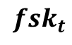


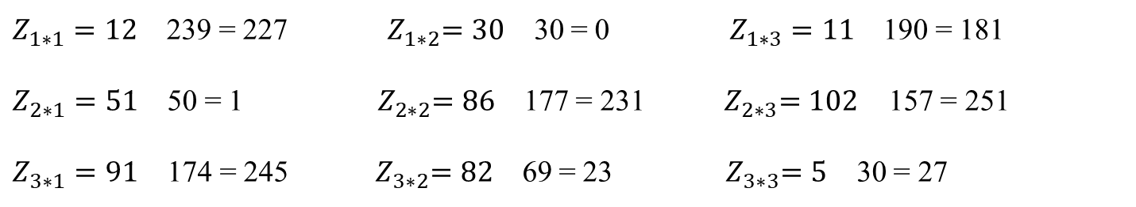
$$Z_{ijc}= {im}_{ijc}$$
$${fsk}_{t}$$
$Z_{1∗1}=12$ 239 = 227 ${ Z}_{1∗2}=30$ 30 = 0 $Z_{1∗3}=11$ 190 = 181
$Z_{2∗1}=51$ 50 = 1 ${ Z}_{2∗2}=86$ 177 = 231 ${ Z}_{2∗3}=102$ 157 = 251
$Z_{3∗1}=91$ 174 = 245 ${ Z}_{3∗2}=82$ 69 = 23 ${ Z}_{3∗3}=5$ 30 = 27
$Z_{ijc}=$ $\begin{matrix}227 & 0 & 181 \\ 1 & 231 & 251 \\ 245 & 23 & 27\end{matrix}$

Slide 13
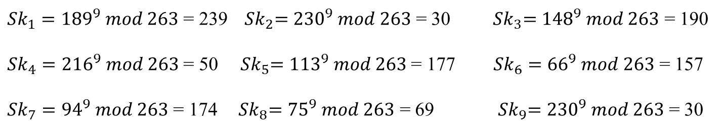

Take fsk= [239,30,190,50,177,157,174,69,30]
fsk= [11101111, 11110, 10111110, 110010, 10110001, 10011101, 10101110, 1000101, 11110]
fsk=[59,3,7,2,47,2,12,2,44,1,39,1,43,2,17,1,7,1]
Decryption:
Sk = ${Bpi}^{x}modp$
${Sk}_{1}={189}^{9} mod 263$ = 239 ${ Sk}_{2}={230}^{9} mod 263$ = 30 ${ Sk}_{3}={148}^{9} mod 263$ = 190
${Sk}_{4}={216}^{9} mod 263$ = 50 ${ Sk}_{5}={113}^{9} mod 263$ = 177 ${Sk}_{6}={66}^{9} mod 263$ = 157
${Sk}_{7}={94}^{9} mod 263$ = 174 ${ Sk}_{8}={75}^{9} mod 263$ = 69 ${ Sk}_{9}={230}^{9} mod 263$ = 30

Slide 14

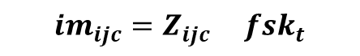
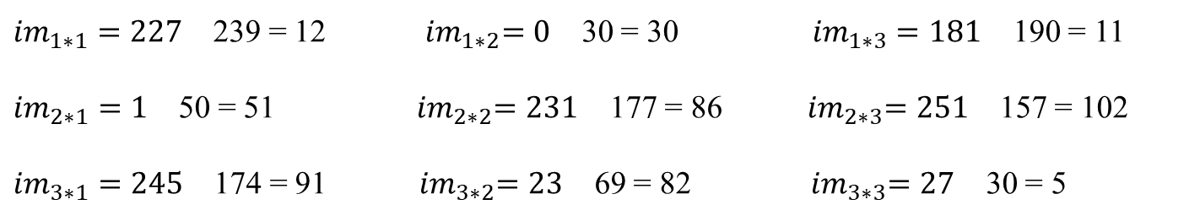
$${im}_{ijc}=Z_{ijc} { fsk}_{t}$$
${im}_{1∗1}=227$ 239 = 12 ${ im}_{1∗2}=0$ 30 = 30 ${im}_{1∗3}=181$ 190 = 11
${im}_{2∗1}=1$ 50 = 51 ${ im}_{2∗2}=231$ 177 = 86 ${ im}_{2∗3}=251$ 157 = 102
${im}_{3∗1}=245$ 174 = 91 ${ im}_{3∗2}=23$ 69 = 82 ${ im}_{3∗3}=27$ 30 = 5
$${im}_{ijc = }\begin{matrix}12 & 30 & 11 \\ 51 & 86 & 102 \\ 91 & 82 & 5\end{matrix}$$

Slide 15
Contents
Abstract
Requirements Analysis
Functional Requirements
Non-functional Requirements
UML Diagrams
Use case diagram
Sequence diagram
State chart diagram
Conclusion

Slide 16
Abstract
El Gamal cryptosystem is one of the well-known public-key algorithms for its ability to generate different ciphertexts for the same plaintext on successive runs. However, this algorithm results in a ciphertext occupying a larger memory space than its plaintext due to its encryption nature. As a result, it is pretty infeasible to use data that require their encrypted form to have the same, such as image data. To overcome this issue, propose a new El Gamal cryptosystem that can be used for any digital data message, including images and text.

Slide 17
FUNCTIONAL REQUIREMENTS
Encryption
Input: Plain image, Public Key values.
Public Key: P, α, Y
Output: Cipher image.
Decryption
Input: Cipher text, Private Key values.
Private Key: x
Output: Plain image.

Slide 18
Hardware Requirements
Processor: Intel i3 & Above
RAM : 4 GB
Hard disk : 512 GB
Keyboard: Standard 102 Keys
Mouse: Standard
Software Requirements:
Operating system: Windows 7 & Above
Programming language: Python Programming

Slide 19
NON -FUNCTIONAL REQUIREMENTS
Usability: The system should be very user-friendly considering that ordinary citizens with or without technology know-how should be able to use it.
Interoperability: The system should be platform-independent; i.e. be accessible from any operating system.
Reliability: This system consistently performs the specified functions without failure.

Slide 20
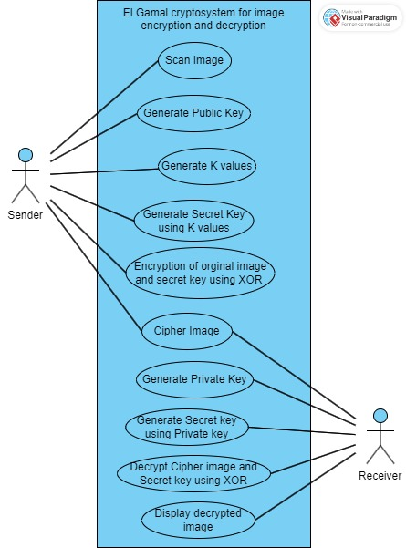
USE CASE
DIAGRAM

Slide 21
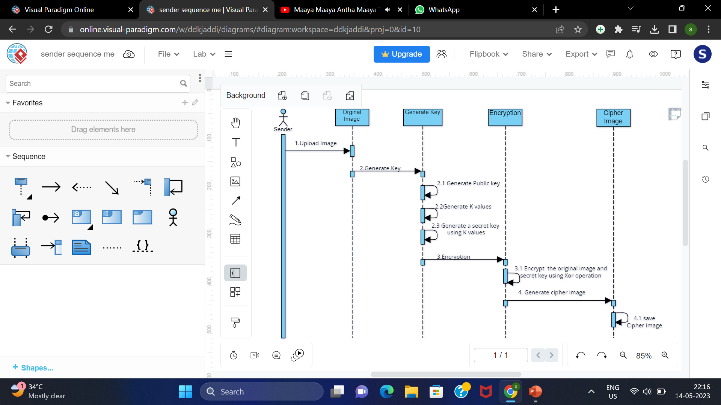
SEQUENCE DIAGRAM for Sender (ENCRYPTION)

Slide 22
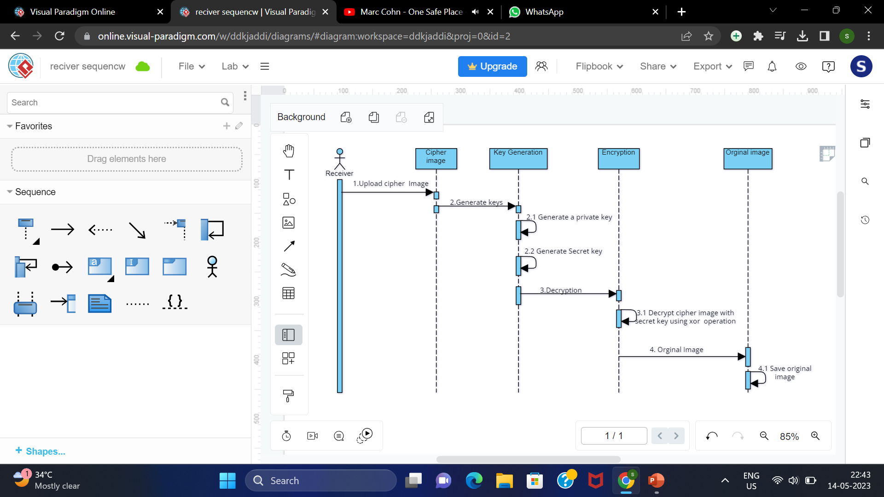
SEQUENCE DIAGRAM for Receiver
(DECRYPTION)

Slide 23
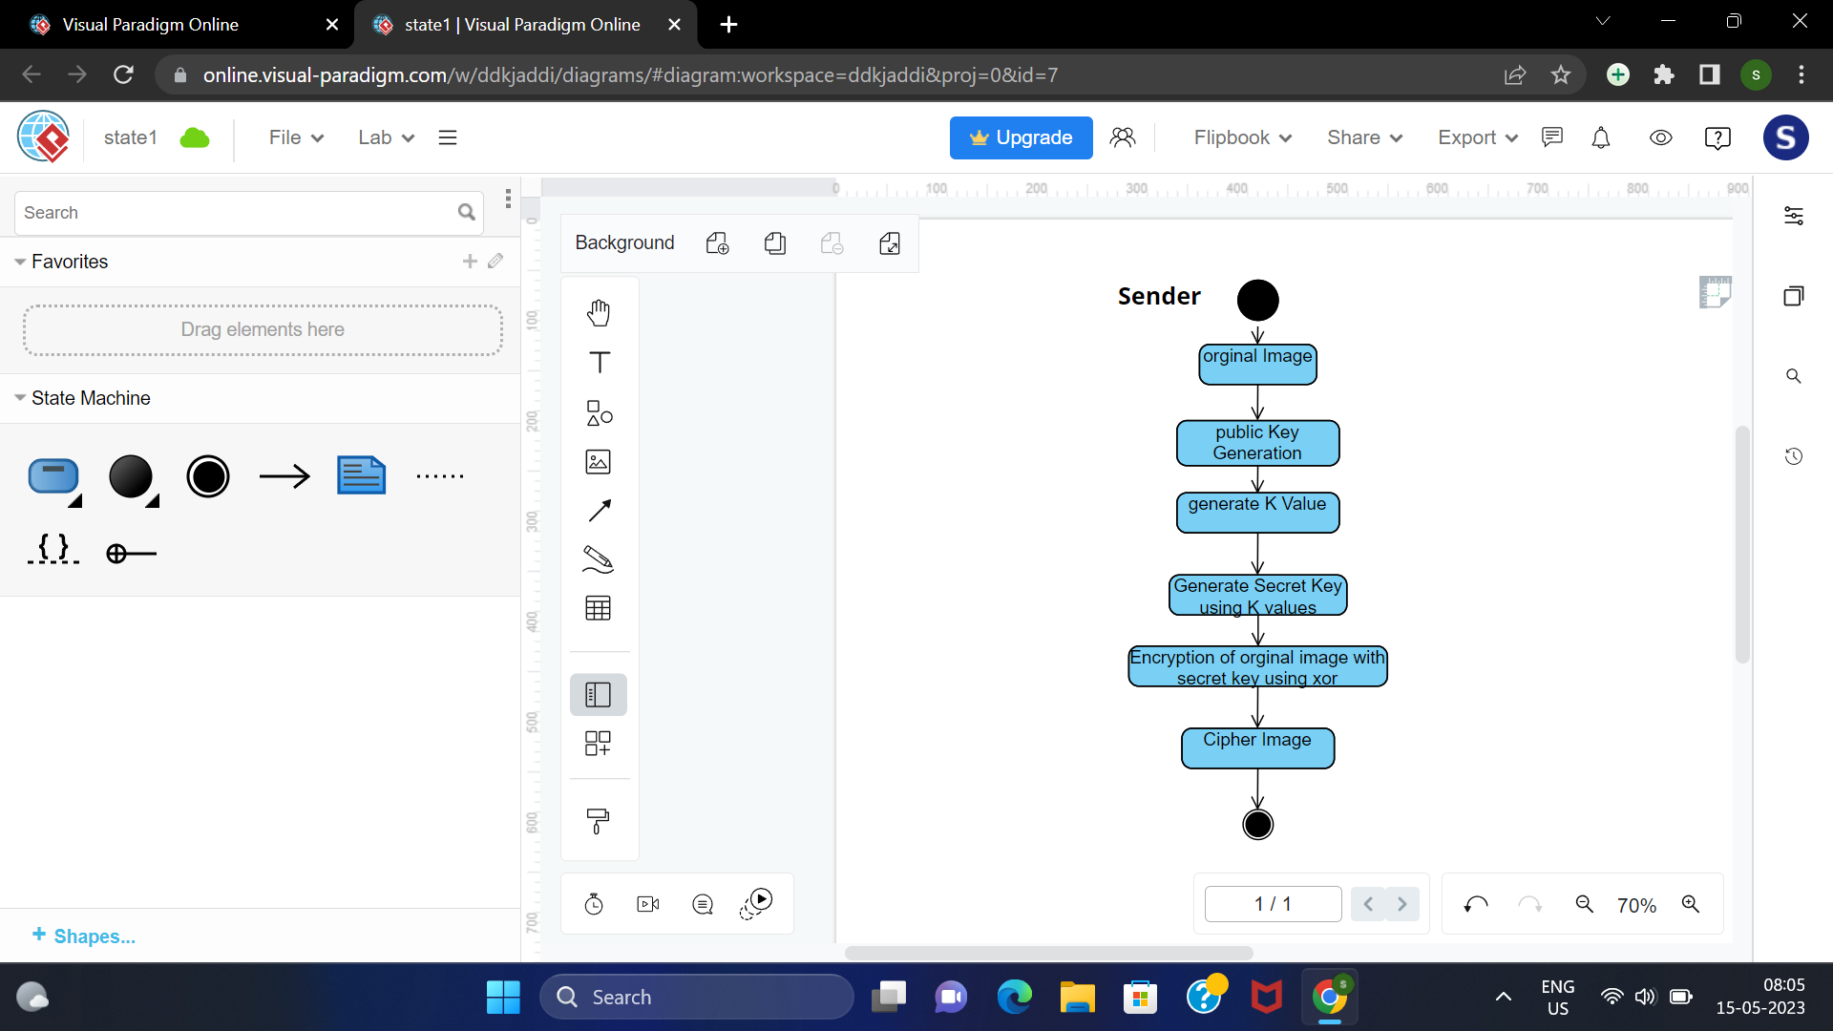
STATE CHART DIAGRAM
For Sender (ENCRYPTION)

Slide 24
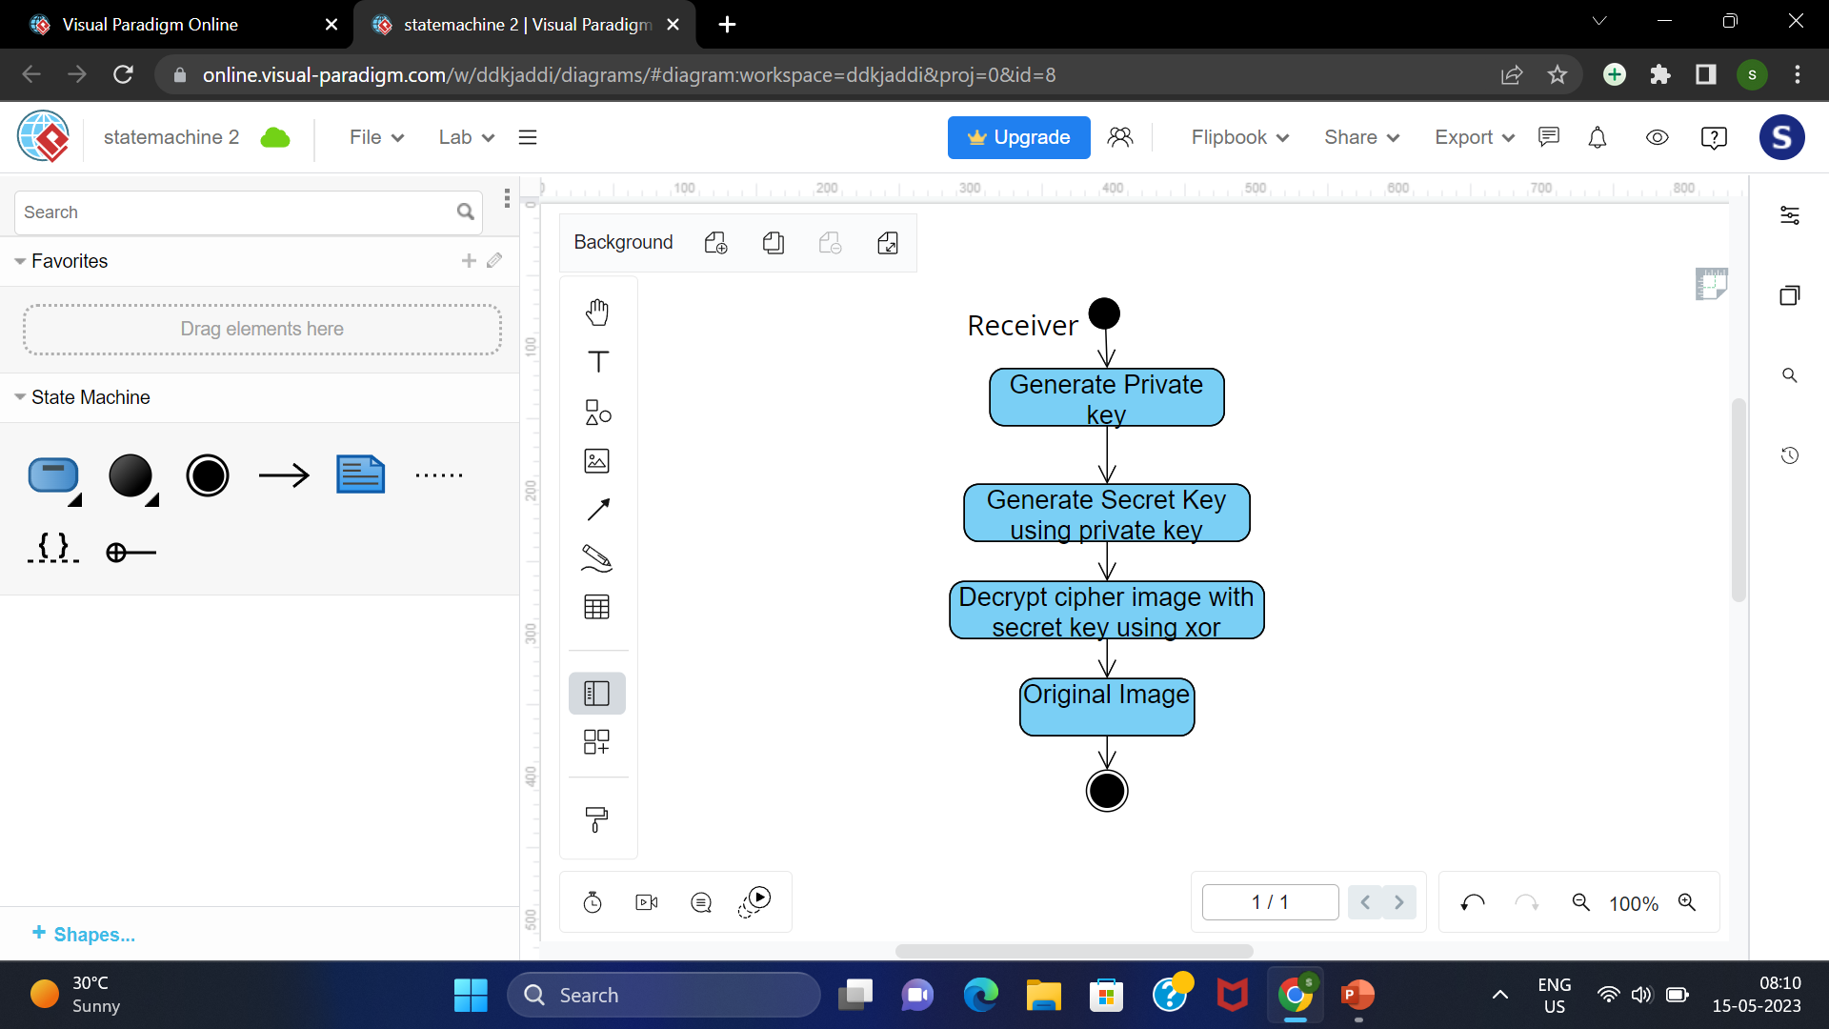
STATE CHART
DIAGRAM
FOR RECEIVER (DECRYPTION)

Slide 25
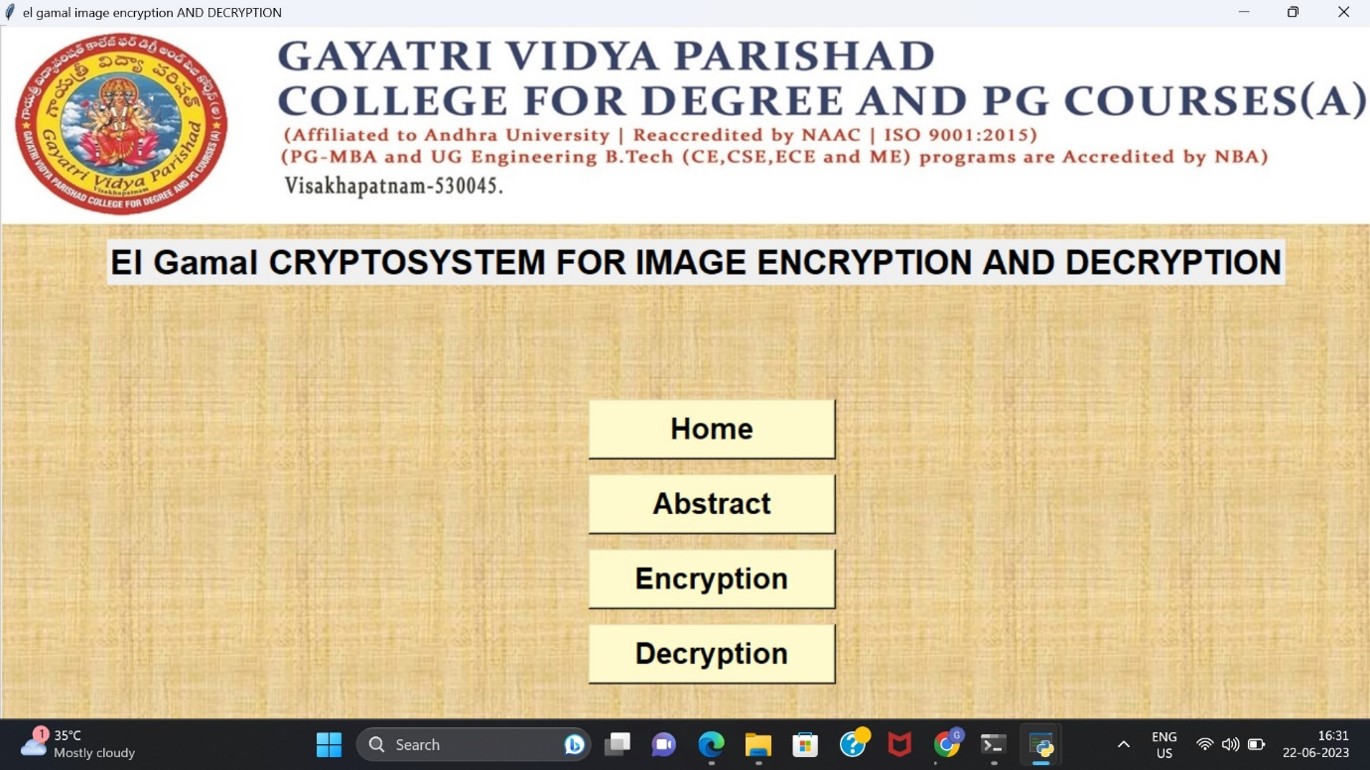

Slide 26
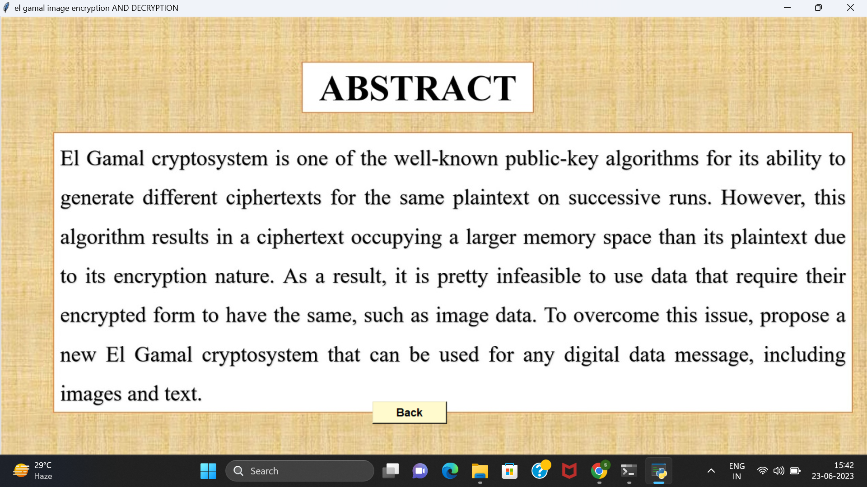

Slide 27
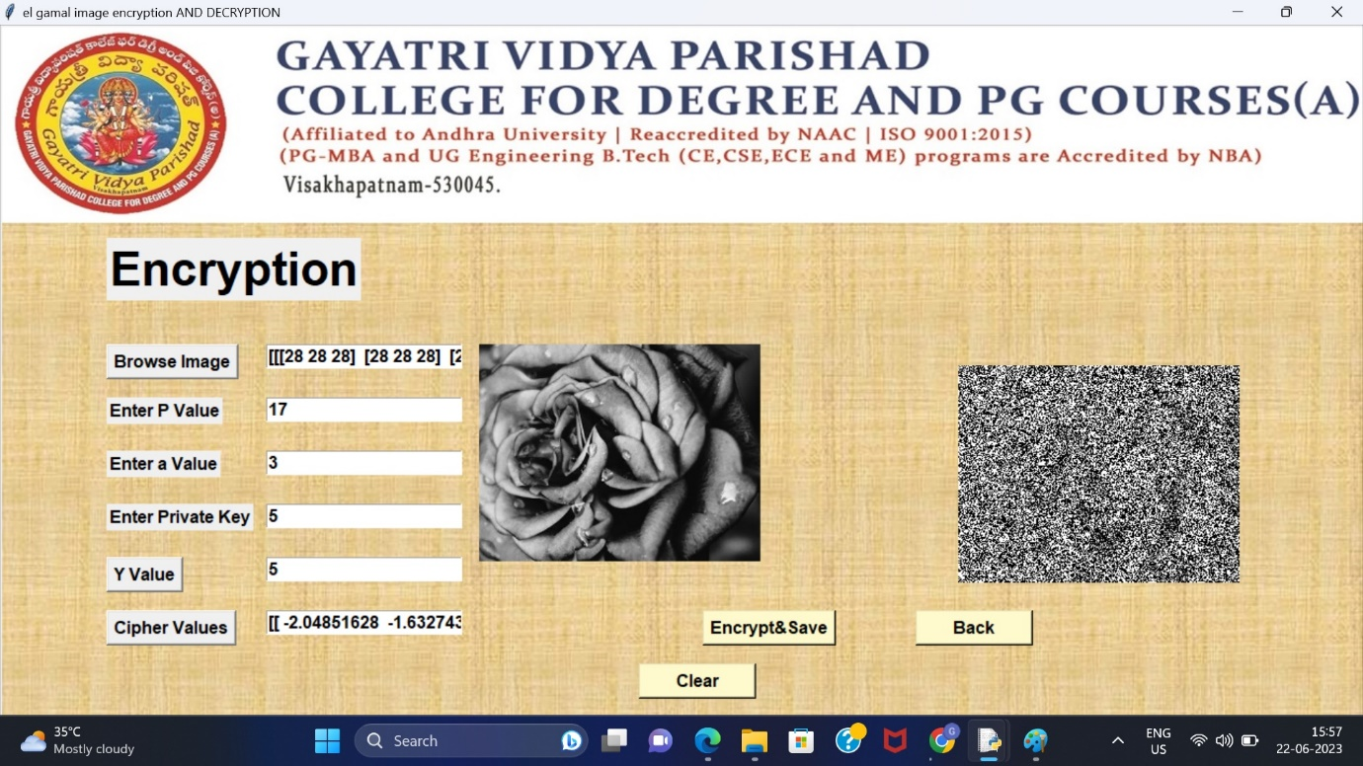

Slide 28
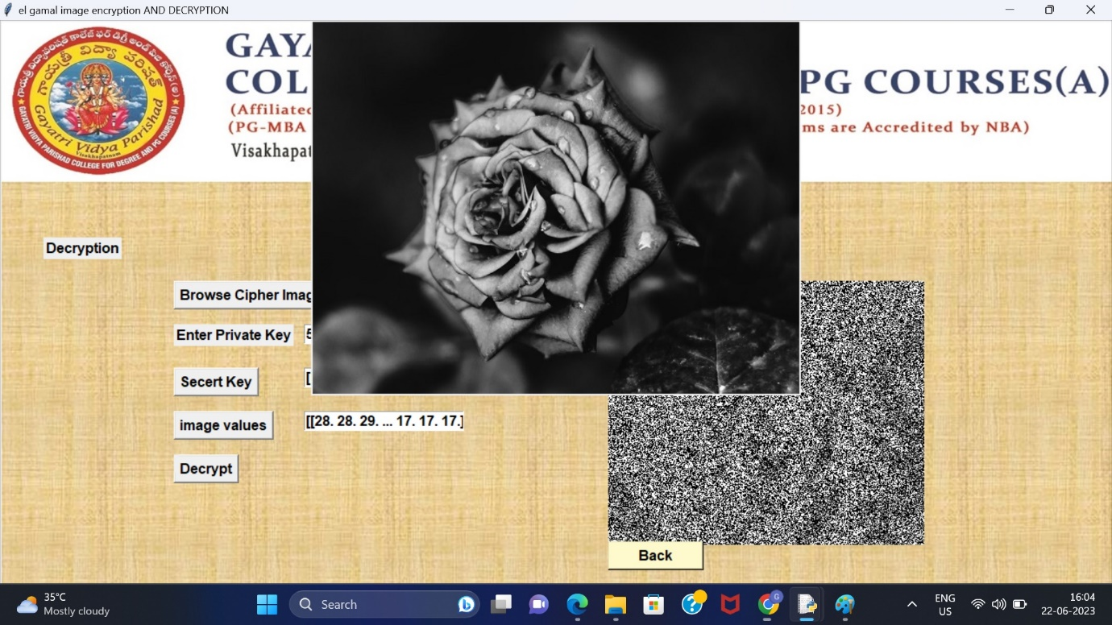

Slide 29
Conclusion
This proposes an efficient image cryptography method called new El Gamal, based on the old El Gamal. The proposed approach has several advantages over the old El Gamal. First, it results in an encrypted image having the same as the original image. Second, the time required for its encryption and decryption processes is much faster since it uses an XOR operation between each pixel and each byte generated randomly rather than using a multiplication operation with a large number used by the old El Gamal. Third, it can be applied to any digital data, such as text and images.

